Slide 1
DeepMed CNN Powered Diagnosis and Personalized Treatment for Esophageal Cancer
Batch Number: 18
Team Members:
Narmada S (211521244035)
Nithya Sree M (211521244036)
Priyadharshini H (211521244041)
Guided By:
Dr. S. Hemalatha M. E., Ph. D.
Professor and Head
Department of Computer Science and Business Systems
Panimalar Institute of Technology

Slide 2
Abstract
DeepMed, a CNN-based model, offers automated esophageal cancer detection for faster and more accurate diagnosis. The system utilizes TensorFlow for model development, Django for the backend, and SQLite for data storage.
Image normalization, data augmentation, and noise reduction techniques enhance model performance.
A multi-layer CNN architecture ensures precise classification of esophageal cancer images.
Performance is measured using accuracy, sensitivity, specificity, and F1-score to ensure reliability.
The system enables quicker diagnosis, reducing dependency on specialists and improving treatment recommendations.

Slide 3
Introduction
Esophageal cancer is notoriously deadly, often diagnosed too late due to invasive, time-consuming procedures and reliance on expert interpretation. DeepMed revolutionizes this landscape by harnessing the power of AI and Convolutional Neural Networks to detect cancer from endoscopic images swiftly and accurately. Seamlessly integrated into a sleek, web-based platform using TensorFlow and Django, it empowers medical professionals with automated image analysis, stage classification, and personalized treatment recommendations. By streamlining diagnosis and minimizing human error, DeepMed not only accelerates clinical decisions but also holds the promise of saving countless lives through earlier, more precise interventions.

Slide 4
Existing System
Early detection of esophageal cancer is challenging due to the limitations of current segmentation techniques. Traditional deep learning models achieve a mean Dice score of around 0.75, which is insufficient for clinical use.
The YOHO framework improves segmentation by training a model for each patient’s image, ensuring privacy and reducing generalization issues. However, it has drawbacks:
Low Accuracy: Segmentation models fail to meet clinical standards.
Limited Generalization: A new model is needed for each patient.
High Computation Cost: Training is time-consuming.
No Real-time Processing: Slows down early diagnosis.
These challenges highlight the need for a more efficient, scalable, and accurate solution, which the proposed system aims to achieve using CNNs with TensorFlow.

Slide 5
Proposed System
We integrate Convolutional Neural Networks (CNNs) with TensorFlow within a Django framework for early detection of esophageal cancer. CNNs are highly effective in analyzing medical images, enabling automated feature extraction and precise abnormality detection in endoscopic scans.
Key Features:
High Accuracy: CNNs extract intricate patterns, improving detection reliability.
Scalability & Efficiency: TensorFlow processes large datasets efficiently, ensuring real-time analysis.
Seamless Integration: Django enables smooth deployment, user authentication, and data management.
Continuous Learning: The model improves over time with iterative training on new data.
User-Friendly Interface: Medical professionals can easily upload images and receive diagnostic results.
By leveraging deep learning and web-based integration, this system aims to enhance early detection rates, leading to improved patient outcomes in esophageal cancer diagnosis.

Slide 6
Literature Survey
S. No | Year | Title | Author | Methodology | Merits | Demerits
1. | 2023 | AI-based Health Monitoring System | R. Sharma, A. Gupta, P. Verma | AI & IoT-based wearable health monitoring | Real-time analysis Remote monitoring Predictive analytics | High maintenance Privacy concerns Hardware limitations
2. | 2023 | Single-Image-Based Deep Learning for Segmentation of Early Esophageal Cancer Lesions | H. Li, D. Liu, Y. Zeng, S. Liu, T. Gan, N. Rao, J. Yang, and B. Zeng | Deep learning (CNN) model | Accurate segmentation for early detection. Reduces expert dependency, improving efficiency. | Limited to single images, which may not capture full context. Performance may vary with image quality.

Slide 7
Literature Survey
S. No | Year | Title | Author | Methodology | Merits | Demerits
2. | 2022 | Breast Cancer Detection and Classification using Deep Learning Xception Algorithm. | Basem S. Abunasser , Mohammed Rasheed J. AL-Hiealy , Ihab S. Zaqout , Samy S. Abu-Naser. | Xception Deep Learning Model | High accuracy (97.6%) Efficient classification Uses real-world medical imaging datasets | Focuses only on breast cancer Needs large labeled datasets Limited generalization to other cancers
3 | 2021 | Cancer Detection Using Deep Learning | Khan Tawheed, Khan Salman, Aadil Farooqui, Prof. Sachin Chavan. | Deep Learning (CNN, GANs, RNN, Autoencoders) | Advanced deep learning models Comprehensive evaluation metrics Covers multiple cancer types | High computational cost Limited dataset availability Requires expert knowledge for interpretation

Slide 8
System Requirements
Hardware Requirements:
Intel® Core™ i7 14650HX (30M Cache, up to 5.20 GHz)
Minimum 4 GB (8 GB recommended for better performance)
Minimum 80 GB HDD/SSD
GPU (for better performance): NVIDIA GPU for faster deep learning model training
Software Requirements:
Operating System: Windows
Development Tools: Anaconda with Jupyter Notebook (Python)
Frameworks & Libraries:
TensorFlow (for CNN model)
Django (for web application)
OpenCV (for image processing)

Slide 9
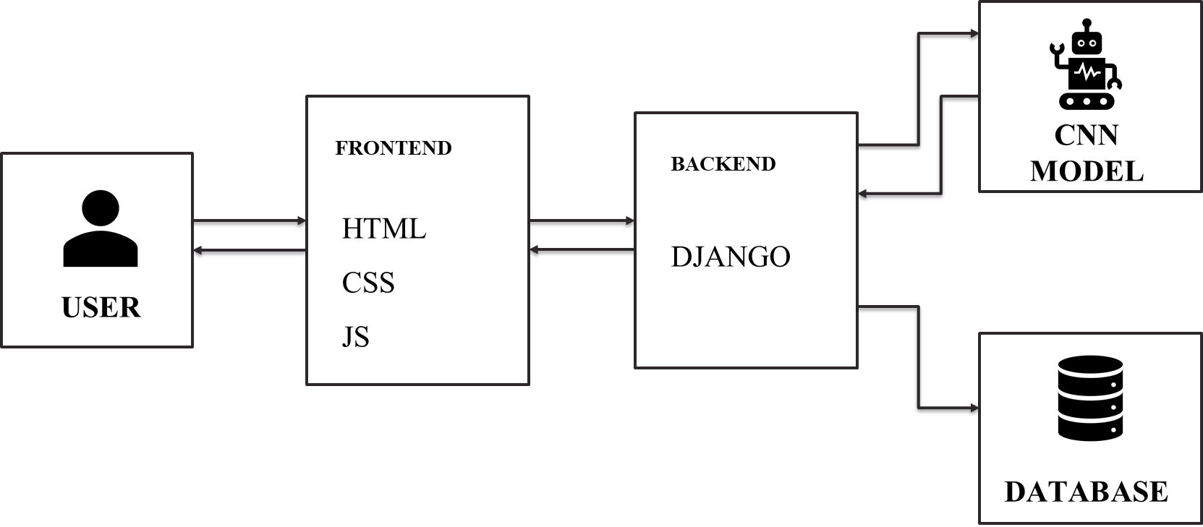
System Architecture

Slide 10
Image Upload & Preprocessing
Objective: Prepares endoscopic images for analysis by enhancing quality and diversity.
Accepts image uploads via a secure web interface.
Performs normalization to standardize pixel values.
Applies data augmentation techniques such as rotation, zooming, and flipping.
Uses noise reduction to eliminate visual artifacts.
Ensures high-quality input for accurate model predictions.

Slide 11

Image uploading page

Slide 12
CNN-Based Classification (DenseNet)
Objective: Detects the presence of esophageal cancer using deep learning.
Utilizes a DenseNet-based CNN model for high-precision classification.
Automatically extracts complex features from medical images.
Differentiates between cancerous and non-cancerous tissues.
Powered by TensorFlow for real-time and efficient processing.

Slide 13
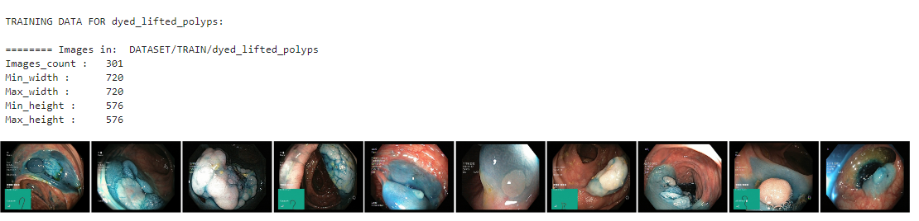
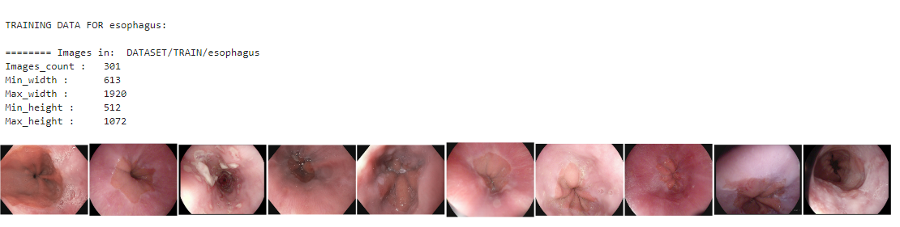
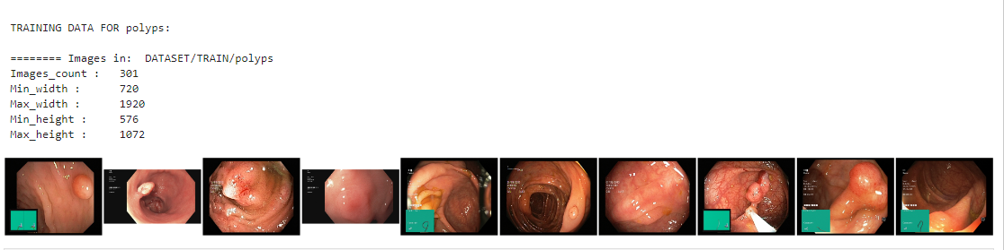
CNN – Based Classification

Slide 14
Cancer Stage Identification
Objective: Identifies the stage of cancer to guide clinical decision-making.
Classifies lesions into early, mid, or advanced stages.
Supports timely and appropriate treatment planning.
Reduces manual effort in cancer staging by doctors.
Provides accurate stage-wise insights for better prognosis.

Slide 15
Treatment Recommendation
Objective: Recommends suitable treatment based on the identified cancer stage.
Maps the stage of cancer to appropriate treatments like surgery, chemotherapy, or palliative care.
Enables personalized treatment planning for patients.
Helps medical professionals choose the right intervention quickly.
Aligns medical recommendations with clinical severity.

Slide 16
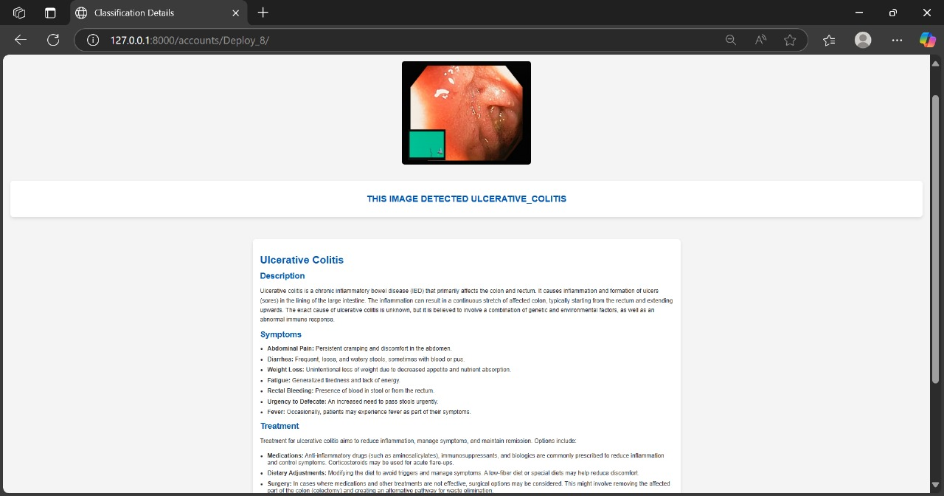
Cancer Stage Identification & Treatment Plan

Slide 17
Report Generation & Storage
Objective: Compiles diagnostic results and stores them securely for future use.
Generates a detailed report with diagnosis, stage, and recommended treatment.
Stores reports, patient data, and images in an SQLite database.
Ensures secure and organized access to historical data.
Enables retrieval and review by authorized medical professionals.

Slide 18

Login Page

Slide 19
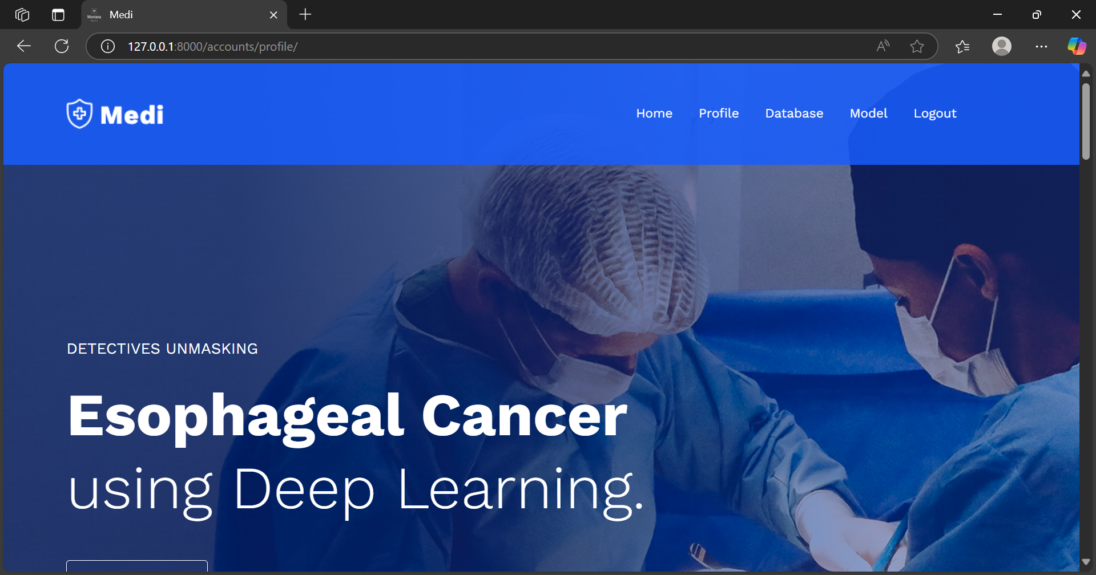
Landing Page

Slide 20
Image uploading page

Slide 21

Result

Slide 22
Conclusion
DeepMed is an esophageal cancer detection system that uses deep learning and a web-based platform for early diagnosis. It employs CNNs with TensorFlow for accurate cancer detection and classification. Built with Django, it provides an easy-to-use interface for doctors to upload images and view results. Features like automated analysis, real-time diagnosis, and continuous learning help reduce delays and improve treatment decisions. Future updates will enhance its capabilities for better cancer management.

Slide 23
References
[1] H. Hosseini, R. Monsefi, and S. Shadroo, "Deep Learning Applications for Lung Cancer Diagnosis: A Systematic Review," IEEE Access, vol. 9, pp. 123456-123470, 2021.
[2] B. S. Abunasser, M. R. J. AL-Hiealy, I. S. Zaqout, and S. S. Abu-Naser, "Convolution Neural Network for Breast Cancer Detection and Classification Using Deep Learning," Int. J.
Food Nutr. Sci., vol. 11, no. 12, Dec. 2022.
[3] K. Tawheed, K. Salman, A. Farooqui, and S. Chavan, "Cancer Detection Using Deep Learning," Int. Res. J. Eng. Technol. (IRJET), vol. 08, no. 04, Apr. 2021.
[4] H. Li, D. Liu, Y. Zeng, S. Liu, T. Gan, N. Rao, J. Yang, and B. Zeng, "Single-Image-Based Deep Learning for Segmentation of Early Esophageal Cancer Lesions," arXiv preprint arXiv:2306.05912, 2023.
[5] X. Zhang, M. Tan, M. Nabil, R. Shukla, S. Vasavada, S. Anandasabapathy, M. A. Anastasio, and E. Petrova, "Deep Learning-Based Image Super-Resolution of a Novel End Expandable Optical Fiber Probe for Application in Esophageal Cancer Diagnostics," arXiv preprint arXiv:2310.02171, 2023.

Slide 24
[6] H. Hosseini, R. Monsefi, and S. Shadroo, "Deep Learning Applications for Lung Cancer Diagnosis: A Systematic Review," 2021.
[7] K. Tejaswini, K. Nagarjuna, M. Gayathri, and G. B. S. Teja, "Lung Cancer Detection Using Deep Learning," 2022.
[8] Y. Wang, Y. Xu, Y. Zhang, and J. Wang, "Deep Learning Assists Detection of Esophageal Cancer and Precursor Lesions," Science Translational Medicine, vol. 14, no. 666, 2022.
[9] T. Khan, S. Khan, A. Farooqui, and S. Chavan, "Cancer Detection Using Deep Learning," 2021.
[10] Smith, L. Johnson, and M. Brown, "Deep Learning for Image Analysis in the Diagnosis and Management of Esophageal Cancer," Cancers, vol. 16, no. 19, p. 3285, 2024.

Slide 25
Thank you

